Slide 1
COT 4521: Introduction to Computational Geometry
Introduction

Slide 2
PhD
Research Assistant Professor
Assistant Professor
2004
2010
2015
Problem Domain
Computer
Graphics
Scientific Visualization
Data Visualization
Problem Solving Approach
Geometric Approaches
Topological Approaches

Slide 3
Introduction
What is computational geometry?
A subfield of the Analysis of Algorithms
Design of efficient algorithms and data structures for geometrical problems
Started in mid 70’s
started out by developing solid theoretical foundations, but became more and more applied over the last years
Deals with geometrical structures
Points, lines, line segments, vectors, planes, etc.
We’ll focus mostly on 2-dimensional geometry, but 3D will be covered when possible

Slide 4
What makes Computational Geometry problems so Interesting/annoying?
Complexity
Curse of dimensionality
Precision error
Avoid floating-point computations whenever possible
Degeneracy
Boundary cases
For example, imagine how 2 line segments can intersect

Slide 5
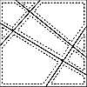
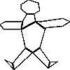
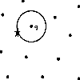
Typical Computational Geometry Problems
Voronoi diagram
simplifying polygons
shape similarity
convex hull
line arrangements
polygon partitioning
nearest neighbor search
Spatial organizations

Slide 6
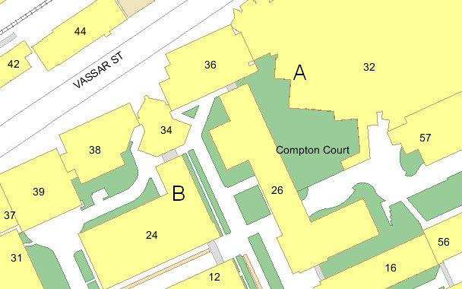
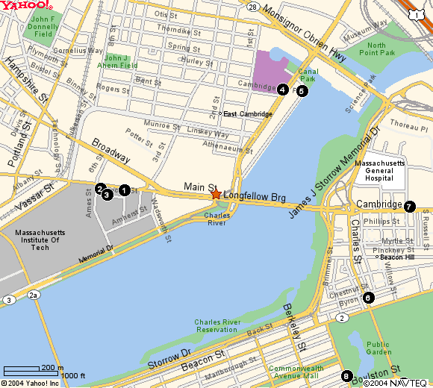
Applications
Computer Graphics
Robotics motion planning
Geographic Information
CAD/CAM
Collision detection
Computer vision
Molecular modeling
VLSI design
Data Mining, Machine Learning, and Visualization

Slide 7

Applications of Computational Geometry
Computer Graphics
For 2D graphics, typical questions involve the intersection of certain primitives, determining the subset of primitives that lie within a particular region, etc.
For 3D graphics, hidden surface removal

Slide 8


Applications of Computational Geometry
Robotic motion planning
The geometric problem arise at many places because robots are geometric objects that operate in a 3D space

Slide 9
Applications of Computational Geometry
Geographic Information system (GIS)
Stores geographical data
Can be used to extract information about certain regions and to obtain information between different types of data

Slide 10
Applications of Computational Geometry
CAD/CAM
Computer-Aided Design
Deal with intersections and unions of objects, with decompositions objects and object boundaries into simpler shapes, and with visualizing the designed products
Computer-Aided Manufacturing
Computer controls the actual manufacturing process

Slide 11
Applications of Computational Geometry
Collision detection
Check whether two (possibly complicated) 3D objects intersect!
Approximate the objects by simple ones that enclose them (bounding volumes)
Popular bounding volumes: boxes, spheres, ellipsoids,...
If bounding volumes don’t intersect, the objects don’t intersect, either
Only if bounding volumes intersect, apply more expensive intersection test(s)

Slide 12
Applications of Computational Geometry
Computer vision
Surface Reconstruction
Step 1: Scan the object (3D laser scanner)
Step 2: Create a triangulation
Step 3: process the triangulation (rendering)
smooth surface in R³
Major Computational Geometry task: Create a “good” triangulation
Pattern recognition
Example: an optical character recognition system

Slide 13
Applications of Computational Geometry
Molecular modeling
Typical questions are to compute the union of the atom balls to obtain the molecule surface or to compute where 2 molecules can touch each other

Slide 14
Applications of Computational Geometry
VLSI design
The process of creating an integrated circuit (IC) by combining thousands of transistors into a single chip

Slide 15
Applications of Computational Geometry
Data Mining, Machine Learning, and Visualization
Many algorithms for operations such as clustering, dimension reduction, classification, and segmentation are based upon geometric approaches.

